Slide 1


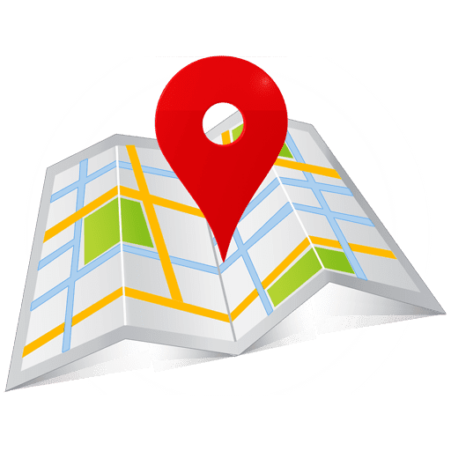
VR Navigation
Prof. Boaz Ben-Moshe
Bar Genish

Slide 2
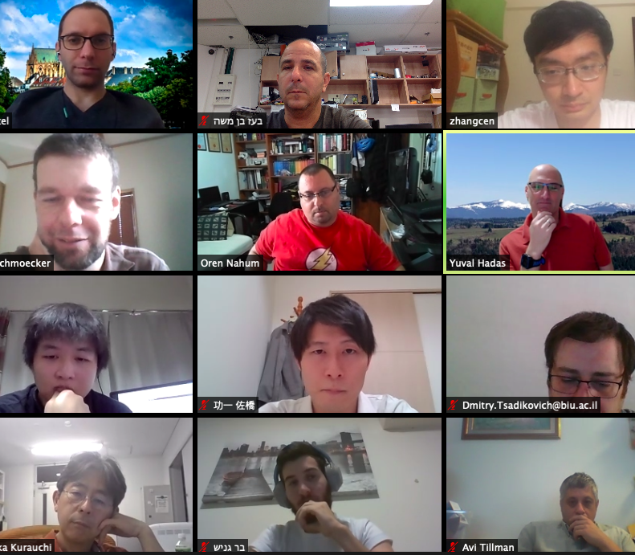
About the project
VR navigation system
Based on a graph
Gets a JSON as an input
Create a virtual tour
Save and export player stats
Big project with Bar-Ilan university

Slide 3
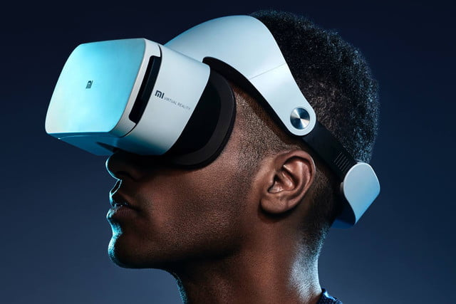
What is VR?
a simulated experience that can be similar to or completely different from the real world.
Used virtual reality headsets.

Slide 4

Why Unity and what is it?
cross-platform game engine
Used for games, film, automotive, architecture, engineering, and construction.
Support VR.

Slide 5

Project Intro
Run-on a mobile device and is compatible with VR headsets.
The user insert his own configuration and 360 pictures defining the spots and connections between them in the system.
Start the tour and travel between spots in VR using the headset.

Slide 6
Design Considerations
The systems environment compound of spots and passages between them.
provide a functionality to display the user current spot, and all possible passages available from the current spot.
Generic structure -> allow the user to configure and modify it freely.

Slide 7

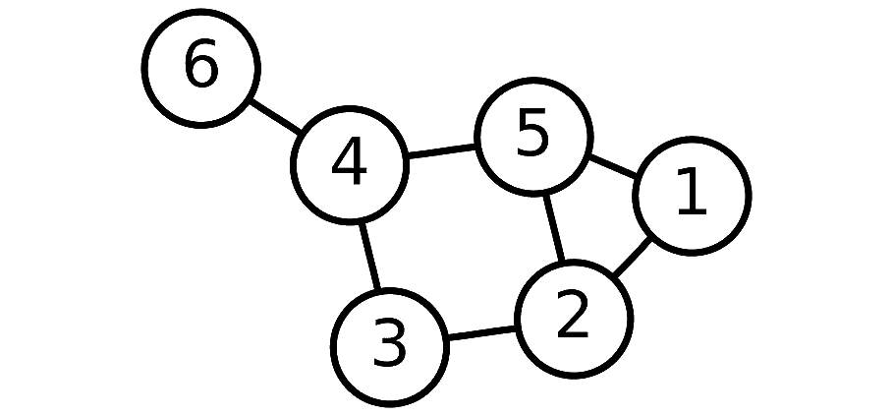
Selected Approach
Graph representation, where each node is a spot and each edge is a possible crossover between spots.
This approach allows the systems to find all possible passages from a specific spot easily as well as find the next spot after choosing a passage.
The system configuration will be in JSON format, representing the graph.

Slide 8
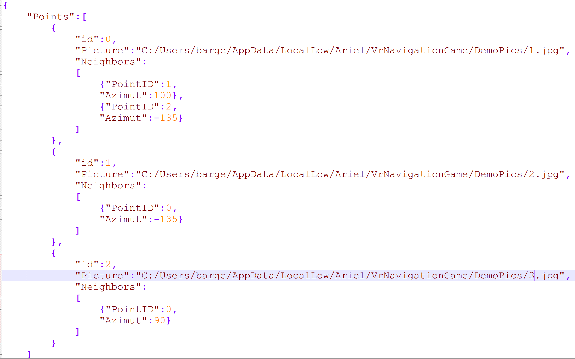
Selected Approach

